Slide 1
Recitation 4:
Feature Engineering
(24-787) Machine Learning and Artificial Intelligence for Engineers
TA: Parth Malpathak
September 23rd , 2022
Notes:
Main title: 40 pt. Arial
Presenter Name: 16 pt. Arial
Presenters Title: 16 pt. Arial Italic

Slide 2
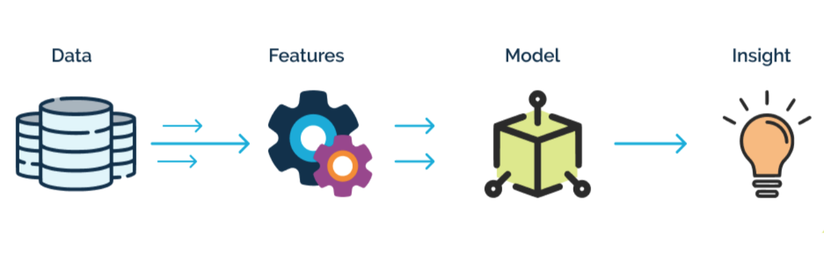
Feature Engineering
Technique of leveraging data to extract features that are absent from the training dataset.
Processes (Overview):
Feature Creation
Transformations
Feature Extractions
Techniques (Overview):
Handling Outliers
One-Hot Encoding
Normalization

Slide 3

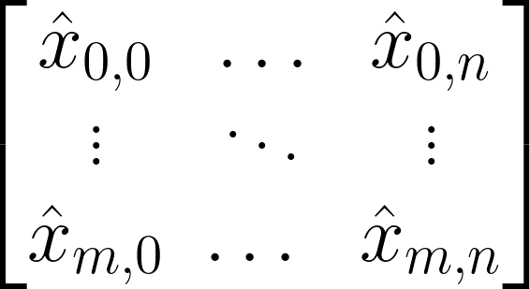
Raw Data
Continuous
Categorical
Ordinal
Feature Engineering
n features
m samples

Slide 4
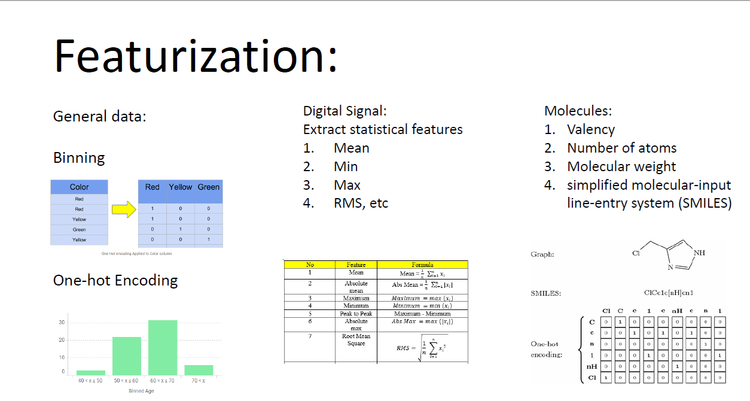

Slide 6
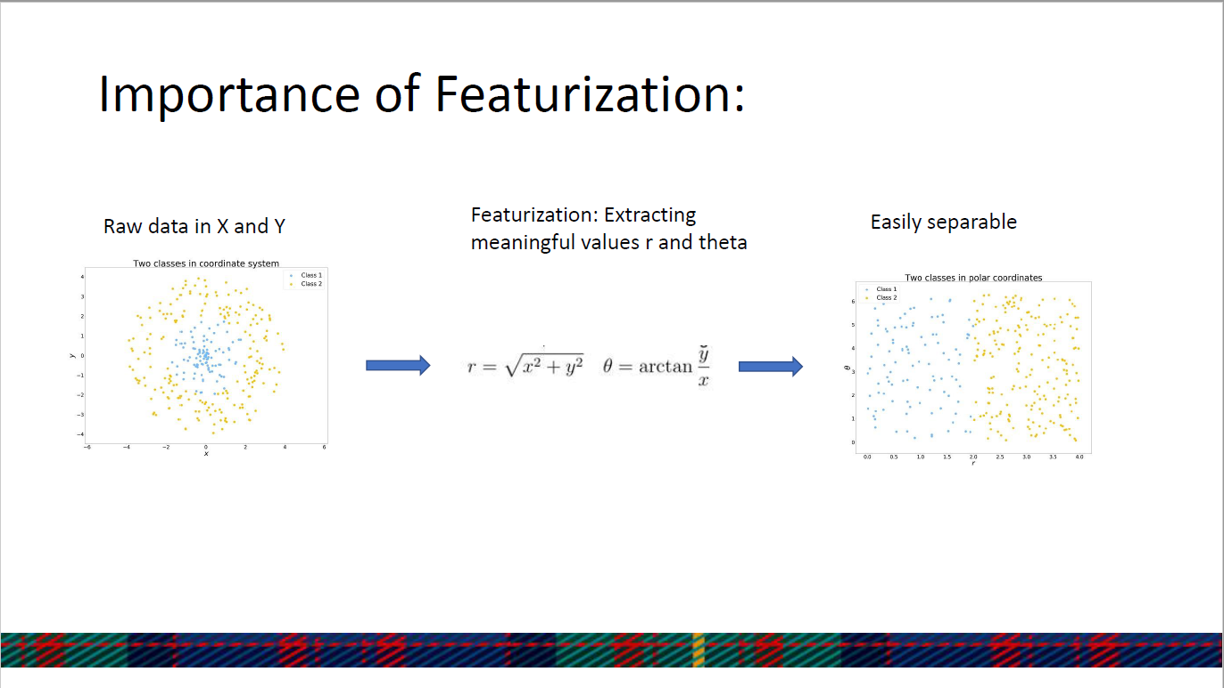

Slide 7

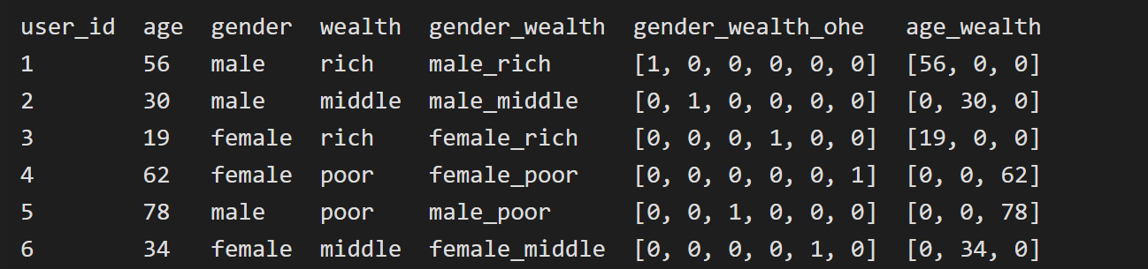
One-Hot Encoding
Feature Scaling
Standardization: Mean: 0, Variance: 1
Normalization (see next slide)
Feature Transformation
Log Transformation, Rounding
Binarization (0,1)
Binning: Categorize (0-20,21-50,51-100)
Label Encoding, One-Hot Encoding
Feature Combination

Slide 8
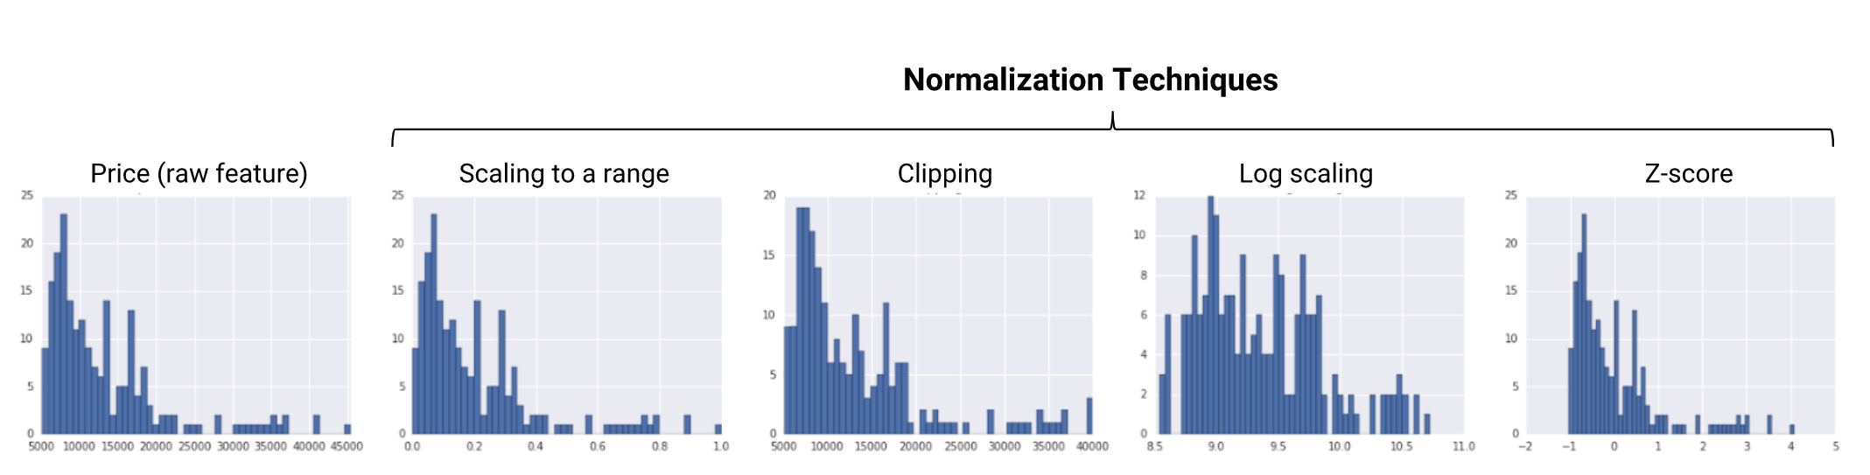
Source: https://developers.google.com/machine-learning/data-prep/transform/normalization

Slide 9
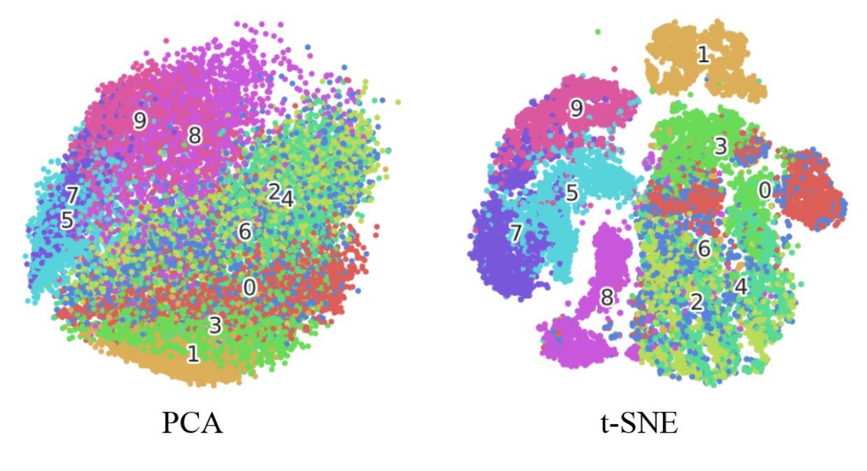
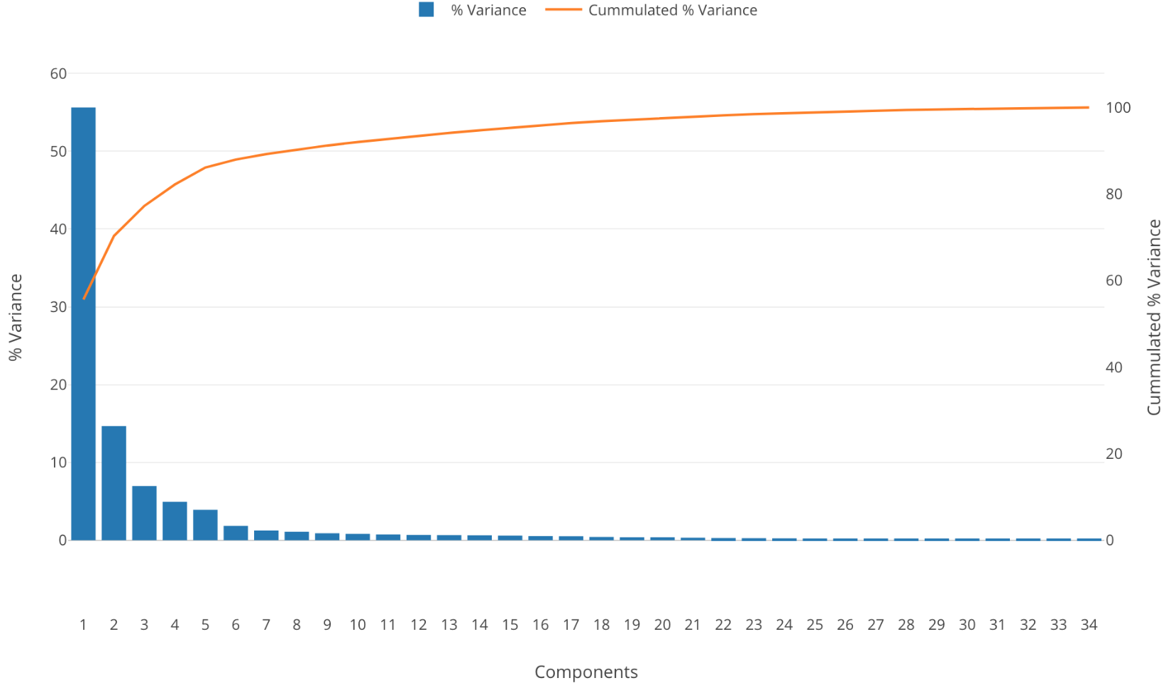
Feature Extraction Dimensionality Reduction (introduced next lecture)
General idea: Remove redundancy between features
Principal Component Analysis (PCA)
Linear Discriminant Analysis (LDA)
T-distributed Stochastic Neighbor Embedding (t-SNE)
Feature Selection
Filtering:
Comparison with some target variable
Chi Square Test: Identify how independent a pair of features are
Information gain
Implementation of feature selection
Give weights/ coefficients
Random Forest Feature Importance
L1-based feature selection: https://scikit-learn.org/stable/modules/feature_selection.html#feature-selection-using-selectfrommodel
Explained Variance with increasing PCs
Notes:
converts similarities between data points to joint probabilities and tries to minimize the Kullback-Leibler
divergence between the joint probabilities of the low-dimensional embedding and the high-dimensional data. T
Linear models penalized with the L1 norm have sparse solutions: many of their estimated coefficients are zero.
When the goal is to reduce the dimensionality of the data to use with another classifier, they can be used along with feature_selection.
SelectFromModel to select the non-zero coefficients. In particular, sparse estimators useful for this purpose are the linear_model.
Lasso for regression, and of linear_model.LogisticRegression and svm.
LinearSVC for classification:

Slide 10
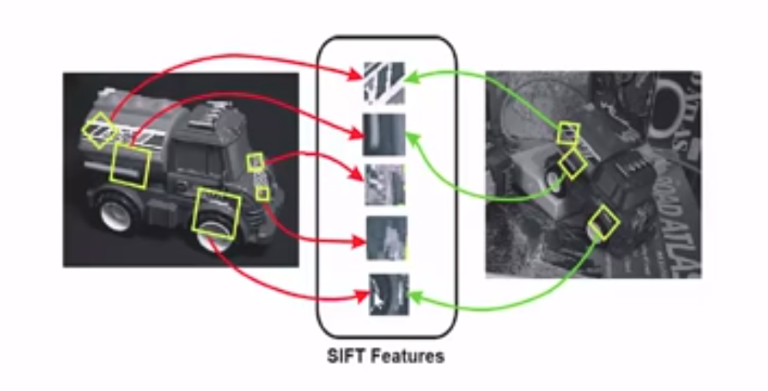
Feature Extraction (Computer Vision)
SIFT: Shift Invariant Feature Transform
Robust to Image rotations, affine transformations, intensity and shift in viewpoint while feature matching.
Each Feature has a descriptor which “Describes” a keypoint.
Keypoints are identified by:
Taking Gaussian Blur in different octaves
Taking Difference of Gaussians
Declaring Local Extrema as Keypoints.

Slide 11
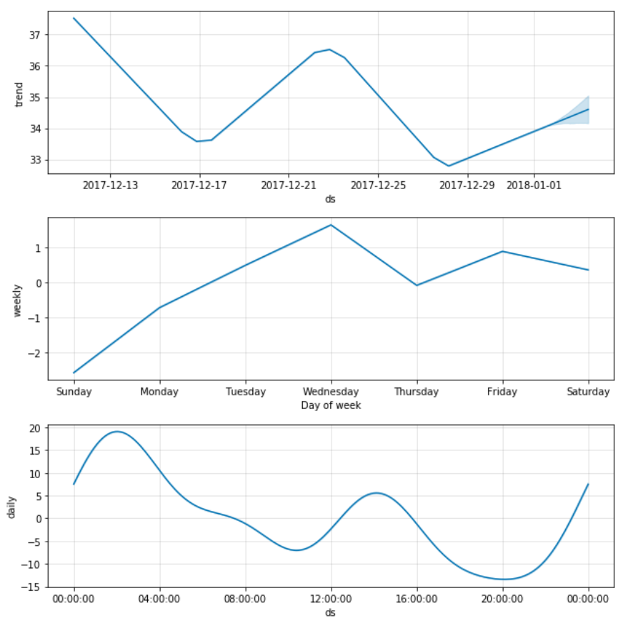
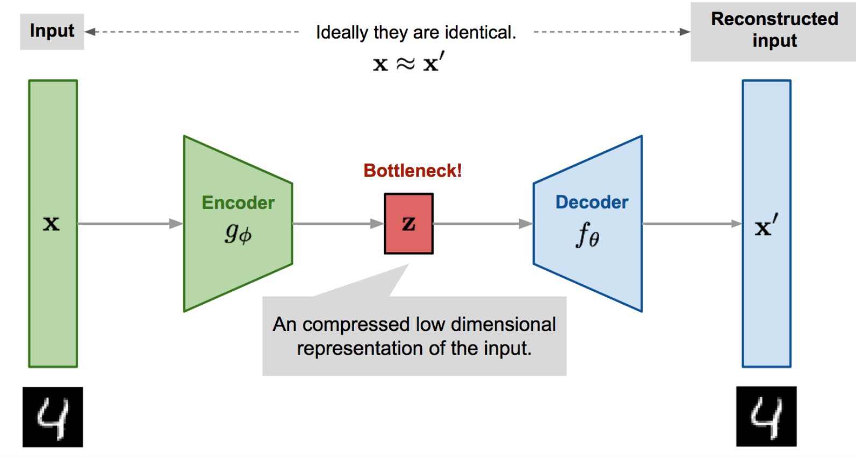
Feature Construction
Temporal Features: Aggregate through time
Spatial Features:
Address → Longitude, Latitude → Median Income within 3 miles
Feature Learning
Deep Learning: Autoencoder
Daily, Weekly, Monthly Trend
https://lilianweng.github.io/lil-log/2018/08/12/from-autoencoder-to-beta-vae.html

Slide 12
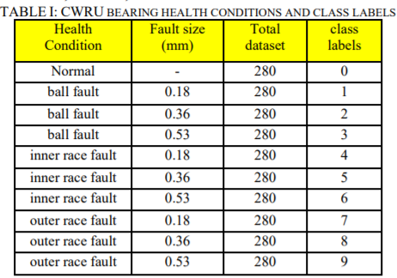
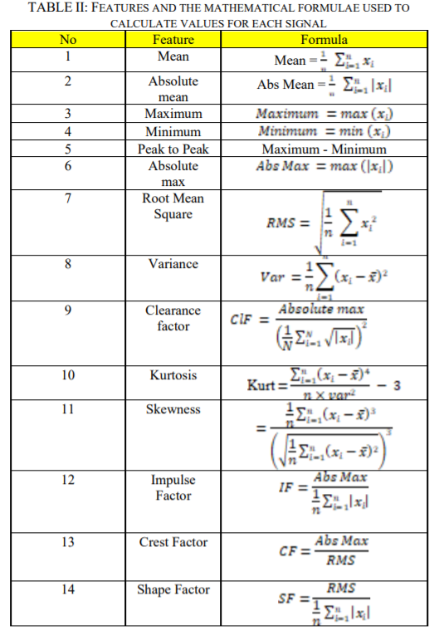
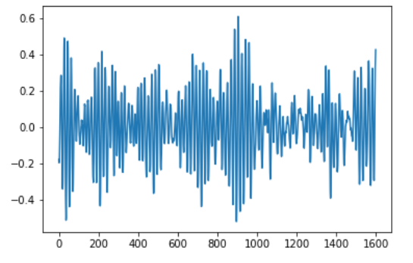
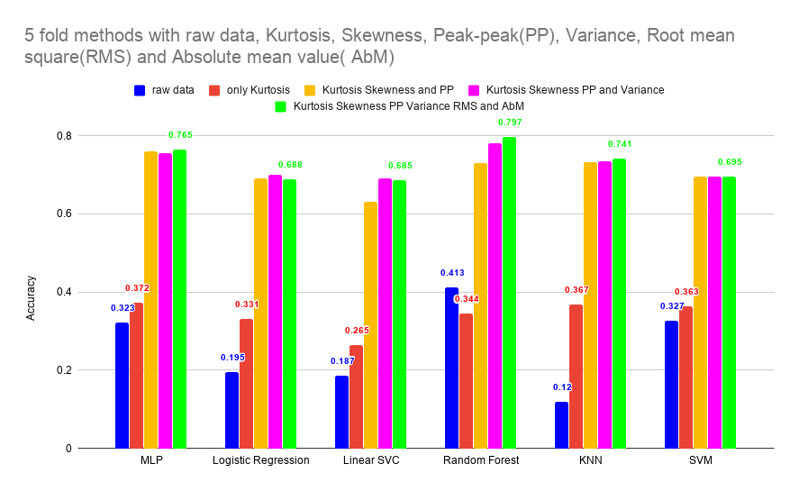
Feature extraction on engineering problem: identifying fault category based on vibration signal
Extracted Features
Signal Data

Slide 13
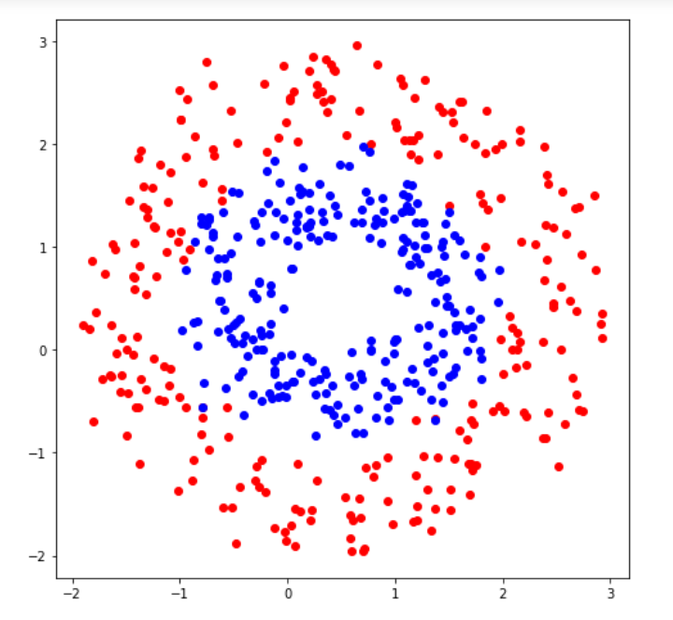
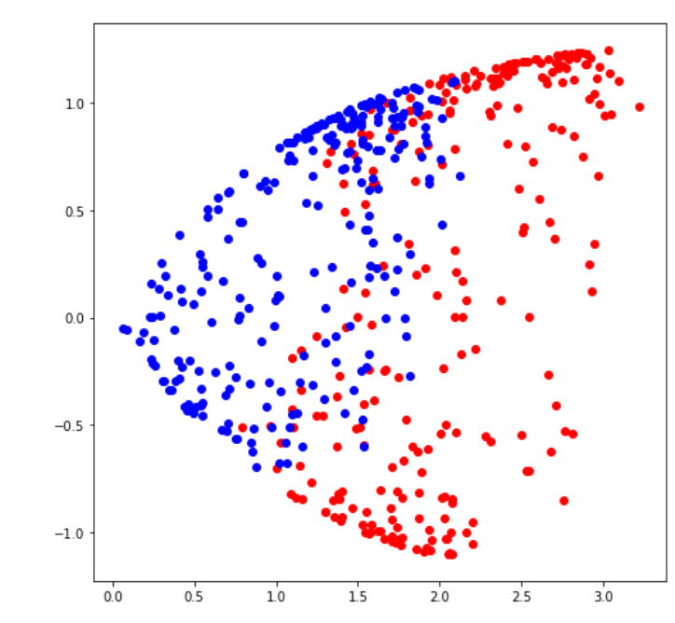
Programming Example – Feature extraction
1. Feature recombination
2. Statistical Feature Engineering

Slide 14
THANK YOU!

Slide 15
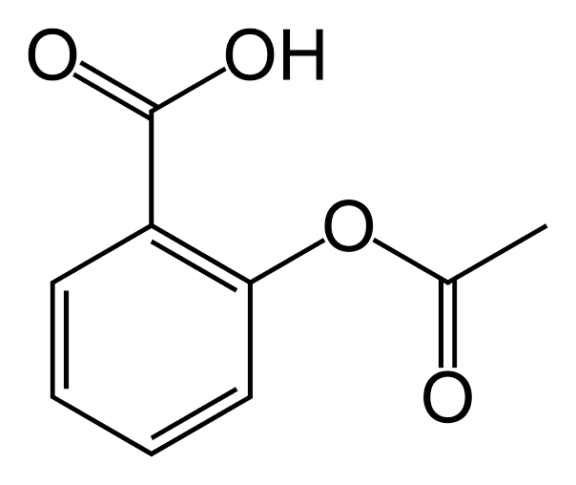
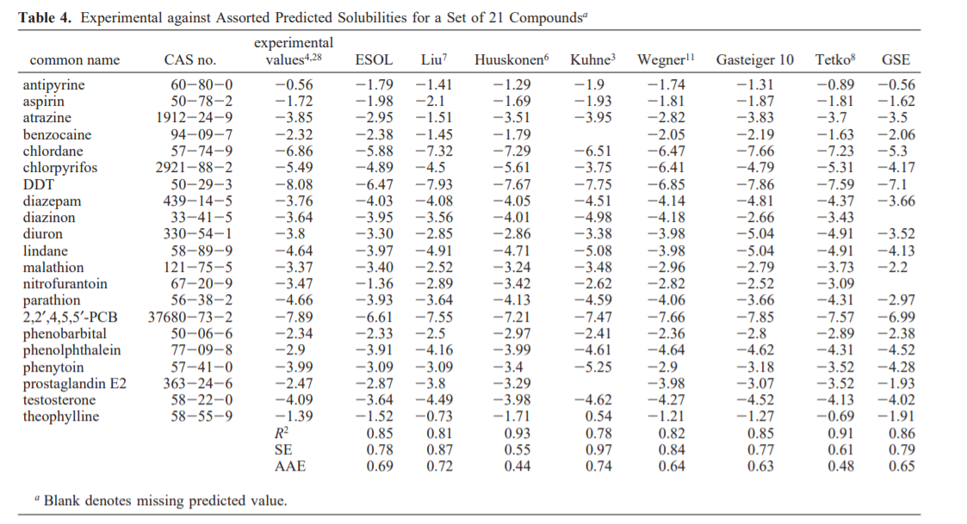
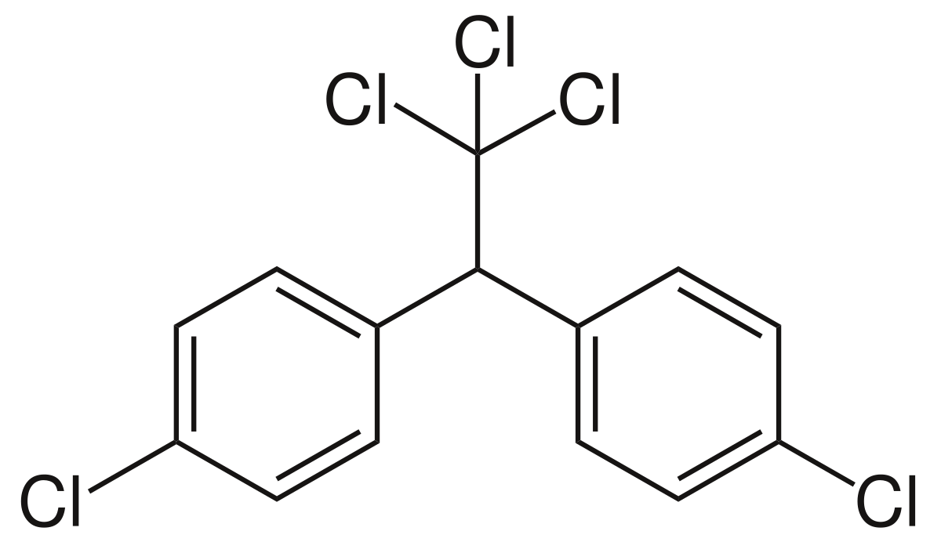
Programming Example 2 – Estimating solubility from molecular information
Input compounds
Predicted Solubility
Aspirin
?
DDT
Delaney, John S. "ESOL: estimating aqueous solubility directly from molecular structure." Journal of chemical information and computer sciences 44, no. 3 (2004): 1000-1005.
?

